Slide 1
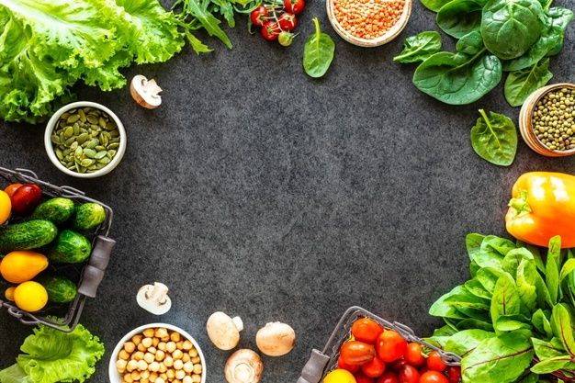
Vitamin Deficiency Detection
(VitaDetect)
SHOBHA
II MSc
P05AZ23S038020

Slide 2

Table of contents
Introduction
Literature Review
Statement of the Problem
Methodology Overview
System Architecture
Web Application Overview
Web Application Designs
Conclusion and Future Work

Slide 3
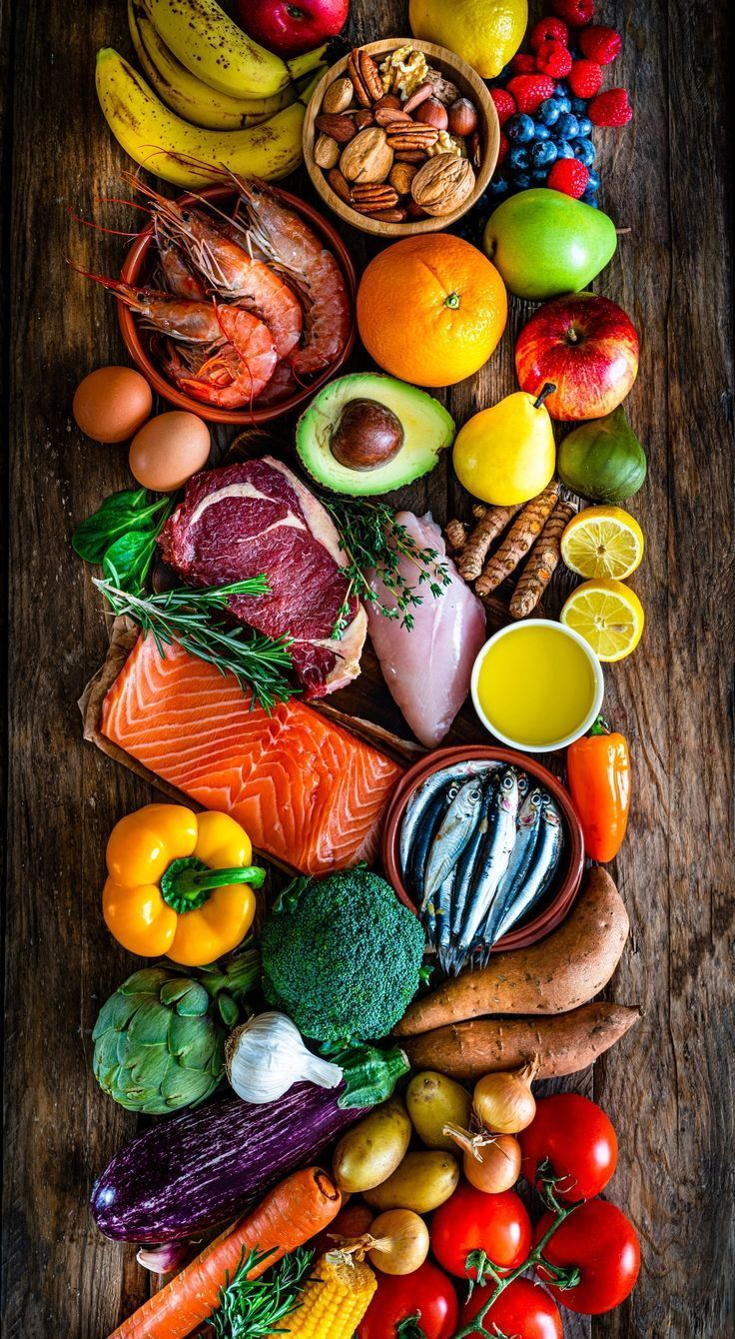
Introduction
Vitamin deficiencies: silent global threat
Lead to physiological, neurological, and developmental disorders
Common in developing countries
Symptoms visible on skin, lips, eyes, tongue, nails before lab detection
Traditional diagnosis limitations:
Invasive (blood tests)
Time-consuming
Expensive and inaccessible to many

Slide 4
Project Overview
Objective: Early, non-invasive vitamin deficiency detection using facial images
Technology: Deep learning + computer vision
Model: Fine-tuned ResNet152V2
Platform: Flask-based web interface
Targeted Nutrients (14 key ones):
Vitamins A, B1, B2, B3, B9, B12, C, D, E, K
Biotin, Iron, Zinc, Protein
Proposed System Features
Real-time facial image classification
Multi-class prediction for 14 deficiencies
Confidence scoring with predictive result
Dietary guidance based on detected deficiency

Slide 5
Why Image-Based Diagnostics?
Advantages:
Non-invasive, cost-effective, widely accessible
Enables mass screenings & personal self-assessment
Reduces dependence on laboratory infrastructure
Key visible symptoms:
Pale/dull skin, cracked lips, tongue discoloration, dark circles, hair thinning
Global Health Impact
Micronutrient deficiencies = “invisible epidemics”
High prevalence in rural & low-resource regions
Often underdiagnosed due to mild symptoms and poor access to healthcare

Slide 6
Literature Review
AI & Medical Image Analysis
AI and Computer Vision are revolutionizing healthcare diagnostics.
Deep Learning, especially CNNs, enables accurate classification of clinical imagery.
Key Research Highlights
Gulshan et al., 2016: Deep learning for diabetic retinopathy detection (accuracy ≈ ophthalmologists).
Esteva et al., 2017: CNNs for skin cancer classification.
Facial features (skin tone, lip dryness, eye puffiness) show visible signs of nutritional deficiencies.
Research Gap
Limited AI-based studies on comprehensive vitamin deficiency detection via facial images.

Slide 7
Our Approach & Contributions
Why CNNs?
ResNet152V2 chosen for:
Deep hierarchical feature extraction
Prevention of gradient vanishing
Transfer learning for limited datasets
Project Contribution
Classifies 14 deficiencies: Vitamins A, B1–B12, C, D, E, K, Biotin, Iron, Zinc, Protein.
Uses custom-labeled dataset for scalable, non-invasive screening.
Key Insights
Deep learning effective for visible-symptom diseases.
Facial analysis = promising non-invasive tool for health monitoring.
This project bridges the research gap in nutritional deficiency detection.

Slide 8
Statement of the Problem
Background
Despite major advancements in medical science, vitamin deficiencies remain widespread.
Early stages are often overlooked due to:
Lack of affordable and accessible diagnostic solutions.
Limited healthcare infrastructure in low-resource regions.
Socioeconomic barriers in rural and underdeveloped areas.
Current Challenges
Conventional diagnosis relies on:
Invasive blood sampling (discomfort & fear, especially for children/elderly).
Dependence on laboratory equipment (HPLC, ELISA, automated analyzers).
Long processing times (hours to days).
Expert interpretation, often unavailable in remote areas.

Slide 9
Key Challenges
Financial Burden
Tests are expensive and not included in routine health check-ups.
Limited Infrastructure
Lack of reagents, equipment, and trained staff in rural and tier-2 clinics.
Invasiveness and Inconvenience
Blood-based tests discourage participation due to needles & sterile requirements.
Low Nutritional Awareness
People misinterpret symptoms like dry lips or facial dullness as minor health issues.
Impact of Delayed Detection
Many avoid or postpone testing, allowing deficiencies to progress into chronic conditions.

Slide 10
Implications & Problem Definition
Consequences of Untreated Deficiencies
Vitamin A → Night blindness, skin roughness
Vitamin B1/B12 → Nerve damage, cardiovascular issues
B2/B3 → Dermatitis, oral inflammation
B9/B12/Iron → Anemia, cognitive delays
C → Bleeding gums, poor immunity
D/Protein → Bone deformities, fatigue
E/K/Zinc/Biotin → Poor wound healing, skin degeneration
Problem Definition
There is a critical need for an accessible, scalable, non-invasive system to detect deficiencies early.
Facial imagery (via smartphones/webcams) offers a low-cost, widely available data source.

Slide 11
Research Question & Proposed Solution
Research Question
"How can we develop a cost-effective, non-invasive, AI-based solution to detect vitamin and mineral deficiencies using facial image analysis?"
Proposed Solution
Deep CNN (ResNet152V2) for deficiency pattern detection.
Custom dataset with 14 nutrient deficiency classes.
Image preprocessing & augmentation for robust performance.
Flask web app for real-time prediction:
Upload photo → Predicted deficiency class + confidence score.
Simple dietary recommendations.
Significance of the Research
Technical Innovation: Leverages AI & deep learning for preventive healthcare.
Social Impact:
Reduces reliance on labs and invasive tests.
Enables mass screening in schools, camps & rural clinics.
Raises public awareness of early deficiency symptoms.
Empowers healthcare workers with accessible tools.
Represents a step forward in democratizing early diagnostics.

Slide 12
Methodology Overview
Objective
Design & implement a Vitamin Deficiency Detection System using deep learning.
Classifies 14 vitamin & nutrient deficiencies via facial image analysis.
Core Technology
ResNet152V2 (Deep CNN) for feature extraction & classification.
Non-invasive, fast, and scalable preliminary screening tool.
Motivation
Certain deficiencies manifest as:
Pallor, skin discoloration, lip dryness, eye puffiness, tongue changes.
Current diagnostic methods: expensive, lab-based, slow.
Goal: automate early detection using facial imagery.

Slide 13
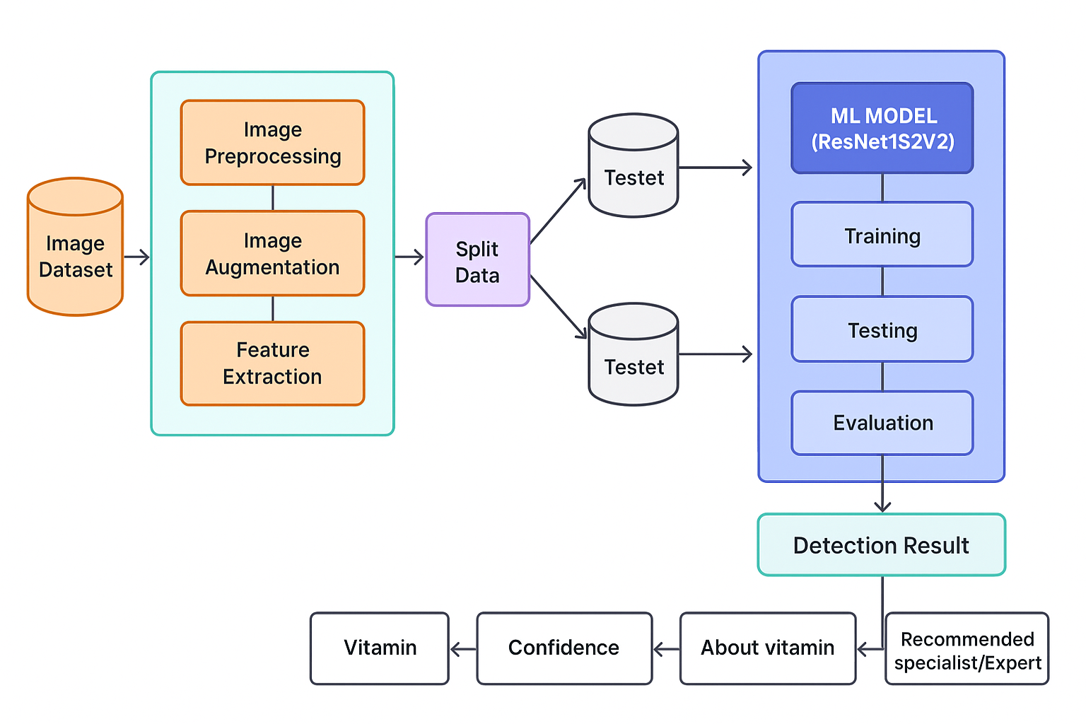
System Architecture
Pipeline
Image Dataset Acquisition
Preprocessing & Augmentation
Feature Extraction (CNN)
Data Splitting (Train/Validation/Test)
Model Training (ResNet152V2)
Prediction & Confidence Scoring
User Output & Specialist Recommendation
Dataset
Source: Kaggle – Vitamin Deficiency Dataset
14 Classes: Vitamins (A, B1–B12, C, D, E, K) & Nutrients (Biotin, Iron, Zinc, Protein).
Total images: 10,480
Training: 7,336
Validation: 1,572
Testing: 1,572

Slide 14
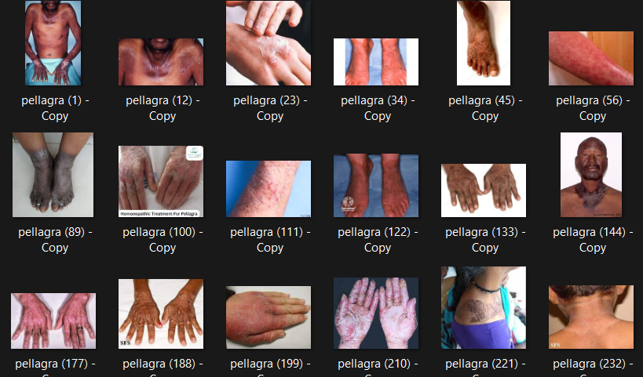
Image Preprocessing & Augmentation
Resizing: 224×224 pixels
Normalization: Pixel values → [0,1]
Noise reduction & standardization
Augmentation Techniques
Horizontal flipping (50%)
Rotation ±20°
Zoom ±15%
Width/Height shift ±10%
Shearing ±15°
Brightness ±20%
Hardware Requirements
Development & Training Environment
Processor: Intel Core i7 / AMD Ryzen 7 or higher
RAM: 16 GB (Recommended: 32 GB)
GPU: NVIDIA GTX 1660Ti / RTX 2060 or higher
VRAM: 6 GB (Recommended: 8 GB or more)
Storage: SSD with 256+ GB free space
Camera: HD webcam (optional for real-time testing)
Deployment (Web Interface)
Processor: Dual-core CPU or higher
RAM: 8 GB minimum
Storage: 100 GB free
Network: Stable internet connection
Software Requirements
Programming & Libraries
Language: Python 3.8+
Core Frameworks: TensorFlow 2.x, Keras
Data Handling: NumPy, Pandas
Visualization: Matplotlib, Seaborn
Evaluation: Scikit-learn
Image Processing
Pillow – For image I/O
OpenCV – For facial image preprocessing
Web Application
Flask – For deployment
HTML/CSS/JavaScript – UI development

Slide 15
Deep Learning Models Explored
Tried Approaches
MLP
Basic CNN
MobileNetV2 (Transfer Learning)
VGG16 (Transfer Learning)
ResNet50
EfficientNetB0
Final Choice: ResNet152V2
152-layer residual CNN
Pre-trained on ImageNet
Fine-tuned with custom layers:
Global Avg Pooling → Dense (2048) → Dropout (0.4) → Dense (1024) → Dropout (0.3) → Softmax (14 classes)
Model Evaluation Summary
Model | Training Time (per epochs) | Accuracy | Key Observation
MLP | ~20 mins | ~45% | Could not capture spatial features; underfitting
Basic CNN | ~35 mins | ~62% | Prone to overfitting; limited generalization
MobileNetV2 | ~28 mins | ~74% | Fast, lightweight; missed fine-grained features
VGG16 | ~50 mins | ~77% | Strong extractor; high computational cost
ResNet50 | ~55 mins | ~80% | Stable, avoided gradient vanishing
EfficientNetB0 | ~48 mins | ~82% | Balanced performance; moderate resource demand
ResNet152V2 (Final) | ~1 hr 15 mins | 86–88% | Best feature extraction; highest stability

Slide 16
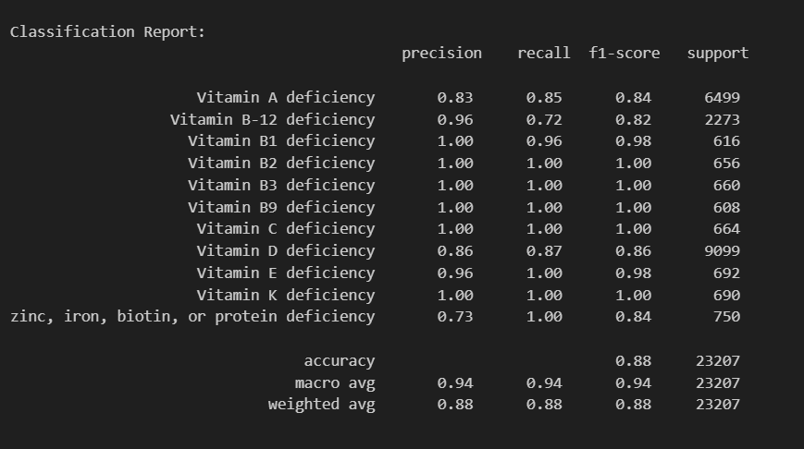
Training Process
Optimizer: Adam (LR = 1e-4)
Loss: Categorical Crossentropy
Epochs: 50
Batch Size: 32
Callbacks
EarlyStopping (patience=5)
ReduceLROnPlateau (factor=0.2, patience=5)
Data Split
Train: 70%
Validation: 15%
Test: 15%
Performance Metrics
Accuracy: Overall prediction correctness
Precision: Accuracy of positive predictions
Recall: Ability to find all true positives
F1-score: Balance between precision & recall

Slide 17
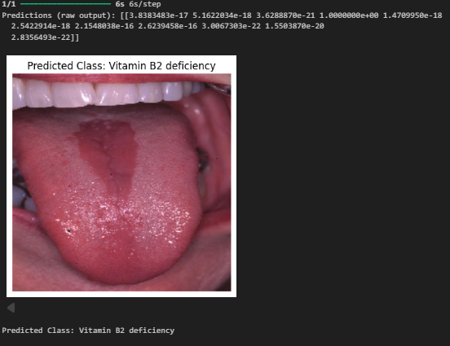
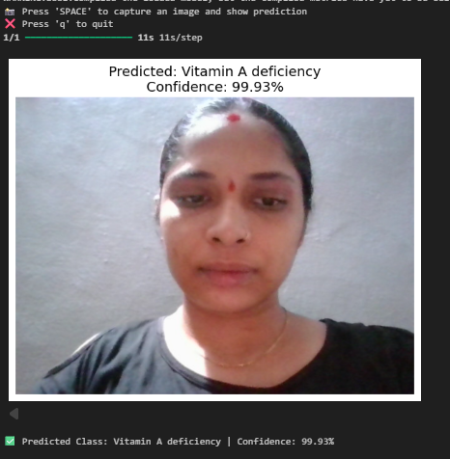
Output & User Interface
Outputs for each image:
Predicted deficiency
Confidence score
Description (symptoms, causes, remedies)
Specialist recommendation
Deployment: Flask-based web app with live webcam capture.
Result:
Image Detection :
Real Time Result :

Slide 18
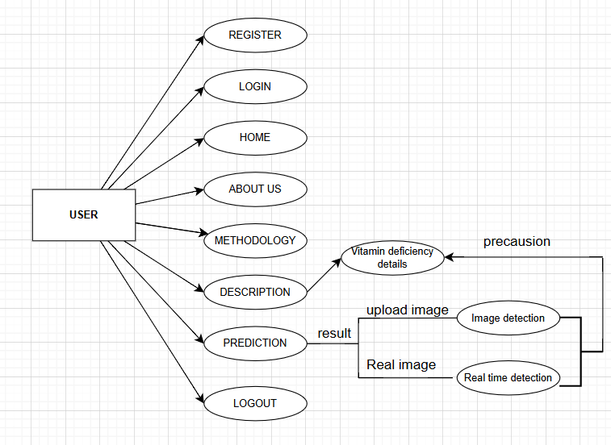
Web Application Overview
Web Application Implementation (VitaDetect)
Purpose: Real-time Vitamin Deficiency Detection via Flask-based web app
Key Features:
Non-invasive nutritional health assessment
Secure user registration/login
Real-time webcam or image upload input
AI-powered prediction engine (ResNet152V2)
Informative educational pages
Core Features
User Registration/Login:
Secure signup with hashed passwords (pbkdf2)
Session-based authentication (Flask-Login)
Image Upload & Prediction:
Upload or real-time capture (OpenCV)
Model integration: 224×224 image preprocessing
Displays predicted deficiency & confidence score
Educational Navigation:
Clickable vitamin cards
Detailed pages with symptoms, remedies, diet

Slide 19
Backend & Database
Backend Structure:
Flask-based server
TensorFlow/Keras for predictions
Prediction flow: preprocess → predict → map class → display
Database Schema (SQLite):
Stores user details (username, email, hashed password)
Unique constraints & timestamps
JSON Response:
Prediction results returned dynamically (AJAX)
Security & Error Handling
Security Measures:
Password hashing (pbkdf2:sha256)
Upload size limiting (16 MB)
UUID-based unique filenames
Input validation (SQL injection, XSS protection)
Session protection for sensitive routes
Error Handling:
Missing uploads & unsupported files
Model load & prediction failure fallback
Logged exceptions for debugging

Slide 20
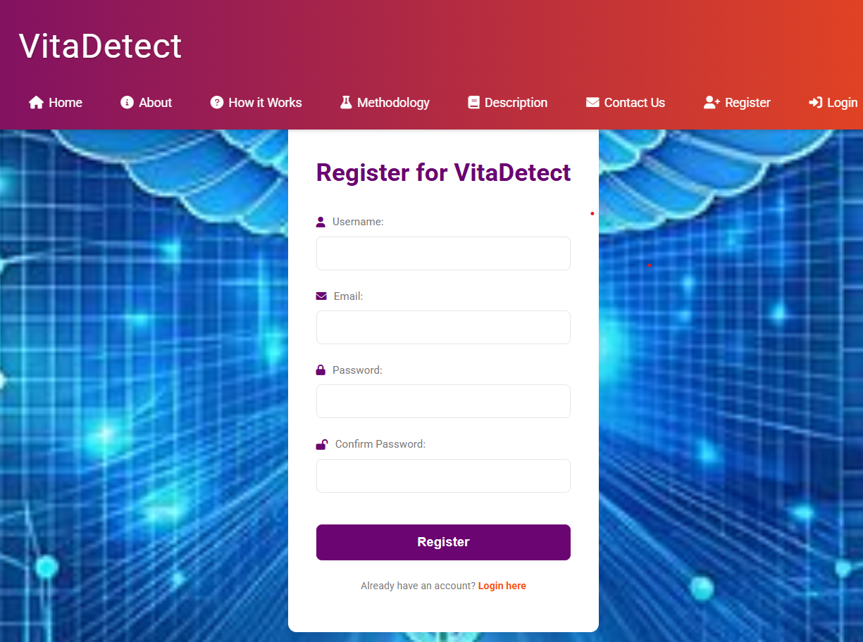
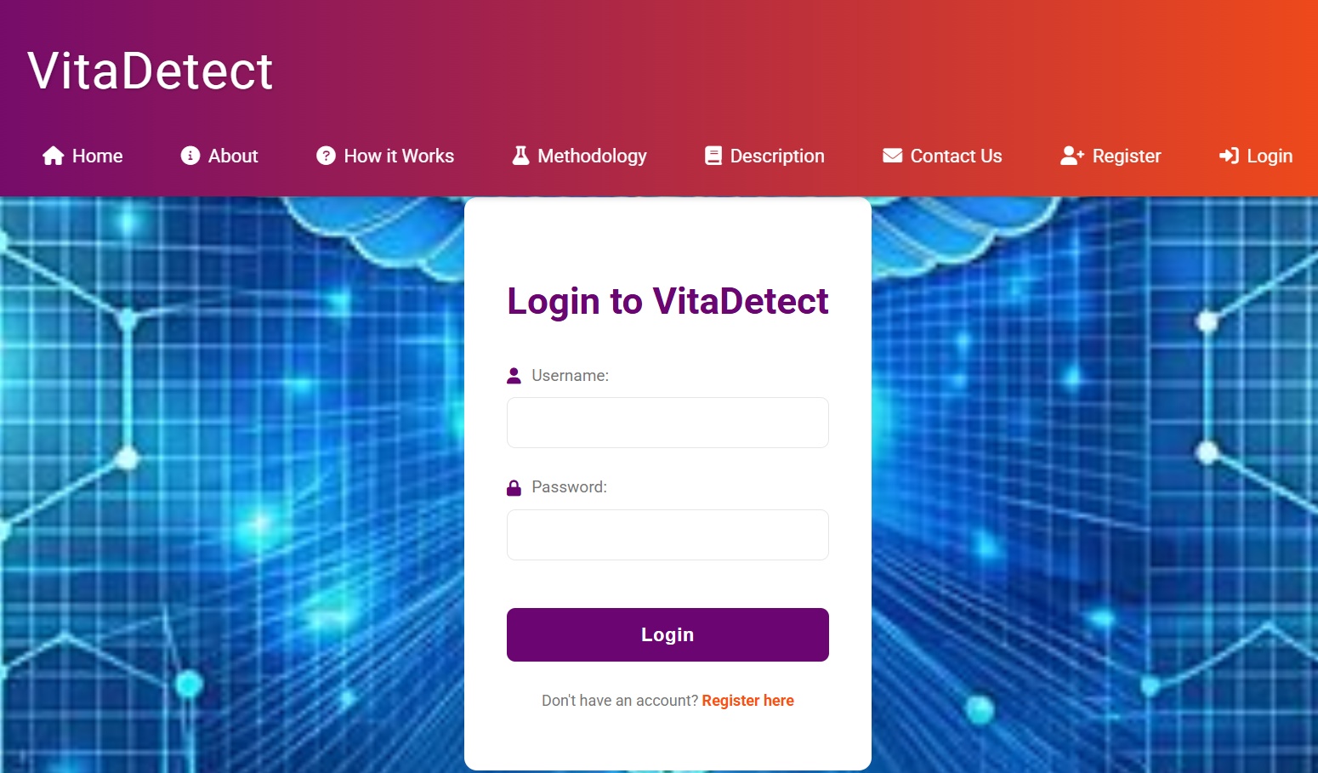
Web application Setups:
Registration page:
Login Page:

Slide 21
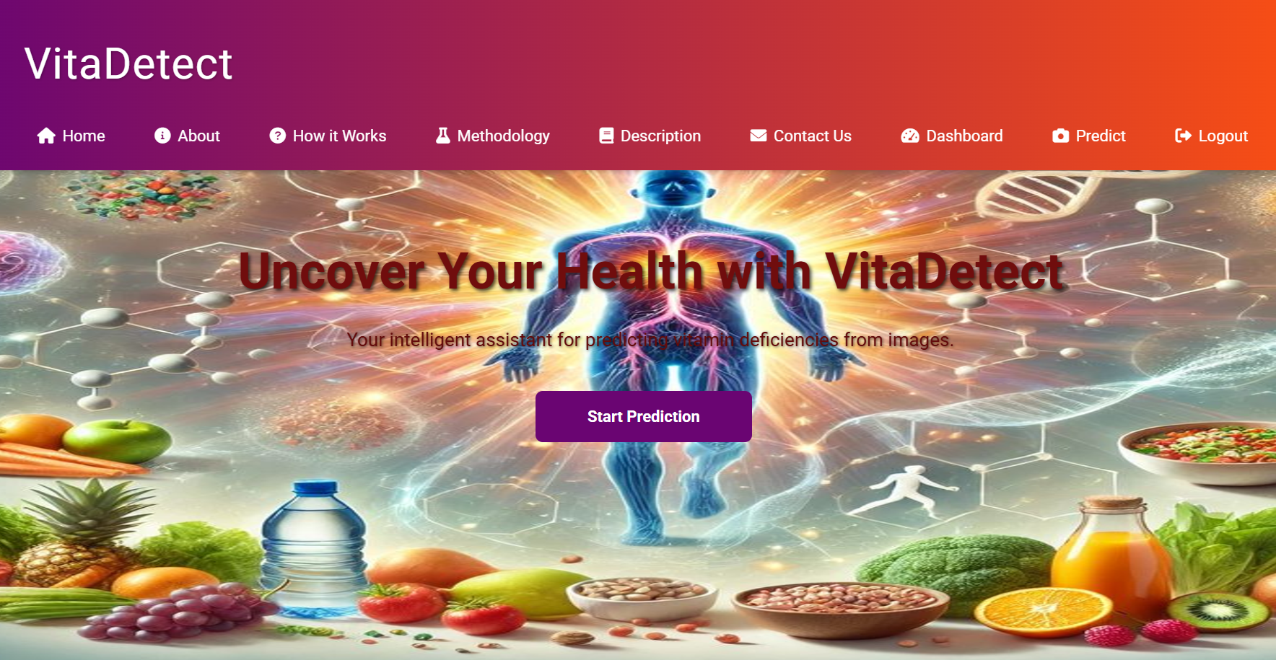
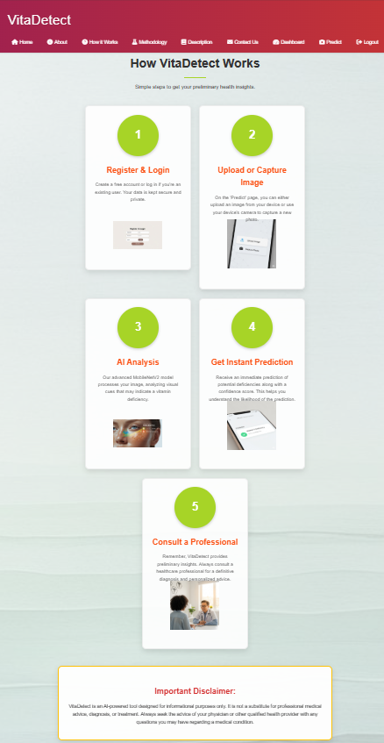
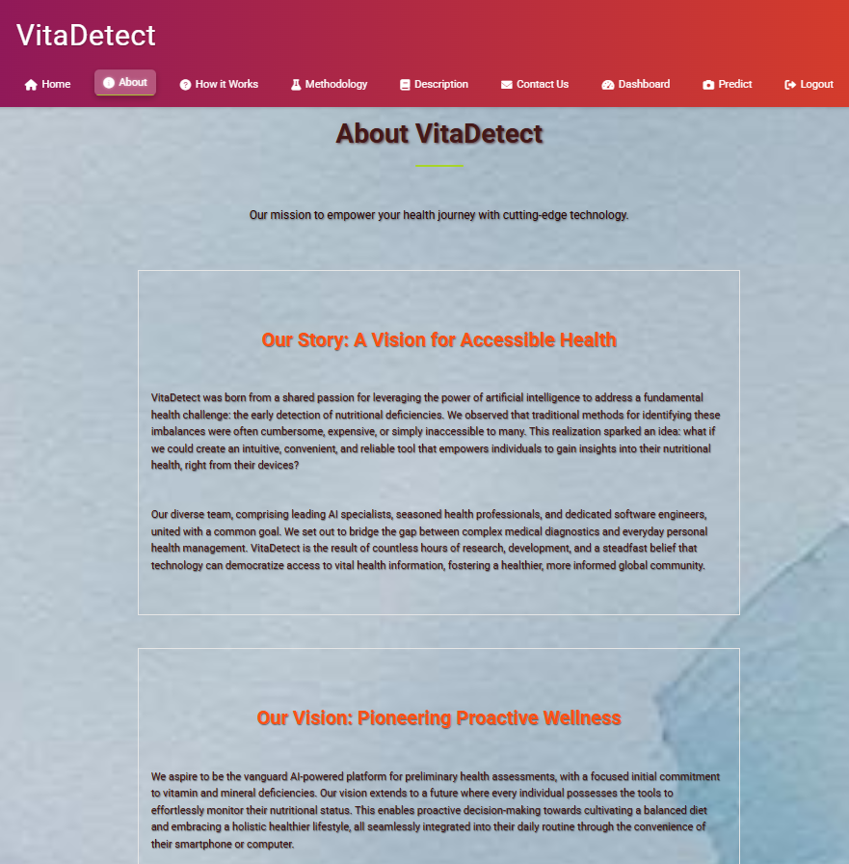
Home Page:
How it works:
About Page:

Slide 22
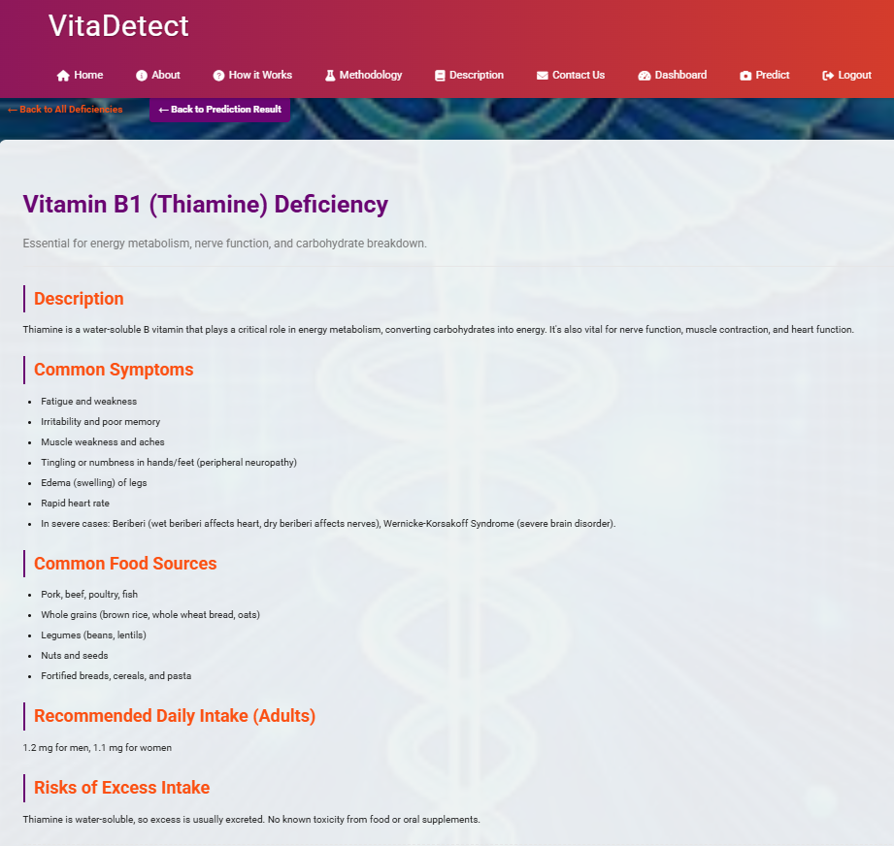
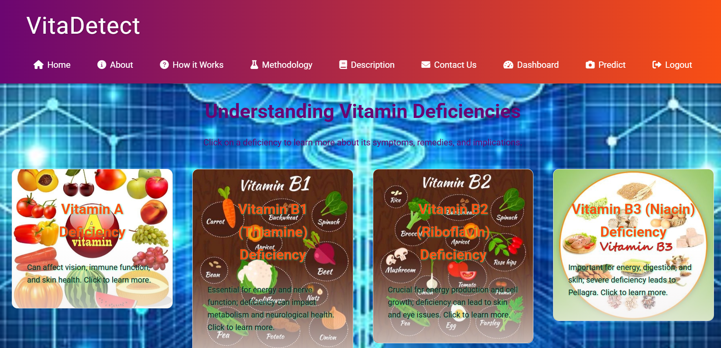
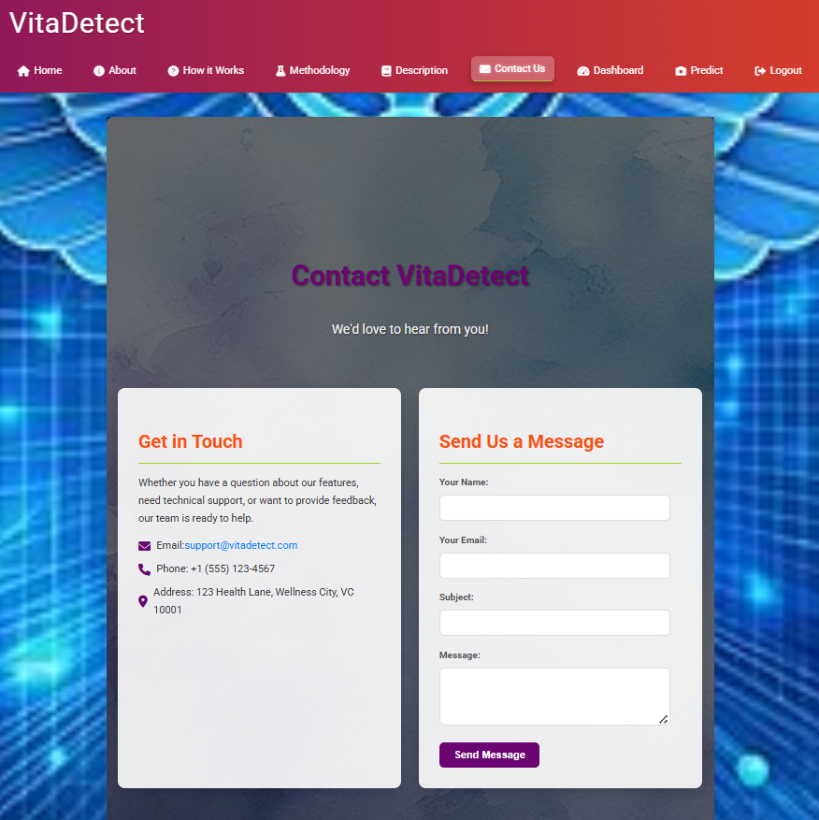
Description page:
Details page:
Contact page:

Slide 23
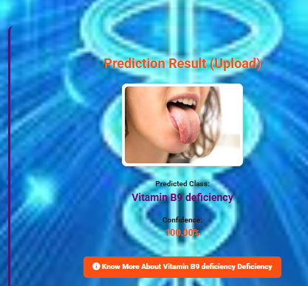
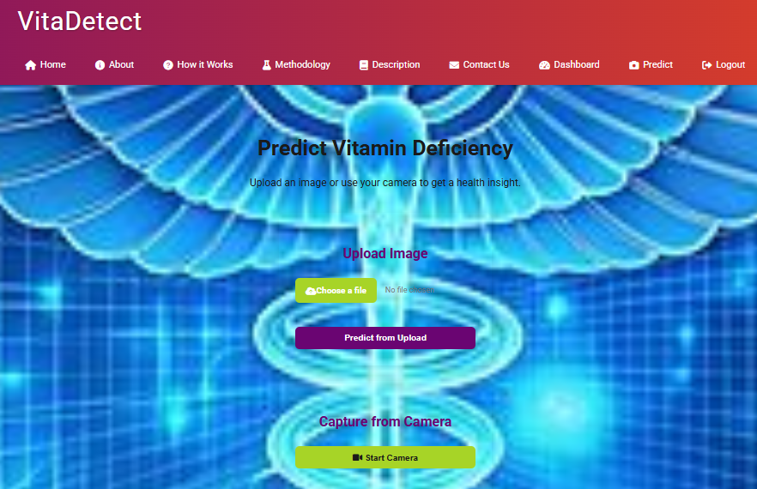
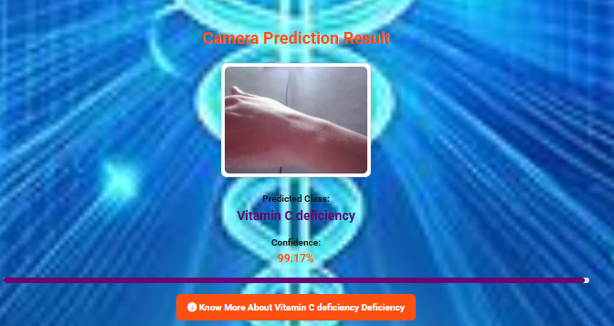
Prediction page:
Upload image Prediction:
Camera Prediction :

Slide 24
Conclusion and Future Work :
Conclusion
Project Achievement:
Developed an AI-powered, non-invasive vitamin & nutrient deficiency detection system.
Utilized ResNet152V2 with carefully preprocessed dataset.
Key Outcomes:
Classified 14 deficiencies (Vitamins A, B1–B12, C, D, E, K, Biotin, Iron, Zinc, Protein).
Achieved high accuracy (86–88%) with robust performance in real-world conditions.
Delivered real-time predictions with confidence scores & dietary suggestions.
Impact:
Eliminates need for invasive tests.
Enhances accessibility & affordability in low-resource areas.
Promotes preventive healthcare via early screening.
Future Work (Roadmap)
Mobile App Deployment: TensorFlow Lite/ONNX for Android & iOS – wider reach.
Multilingual Support: Regional languages for rural accessibility.
Larger Dataset: Diverse skin tones, age groups – improved generalization.
Additional Biomarkers: Integrate eyes, nails, hair for higher accuracy.
Cloud Deployment: SaaS for hospitals & NGOs – scalable public health screening.

Slide 25
Advanced Enhancements
Dataset Expansion & Diversity:
Include controlled lab-confirmed data for better label reliability.
Multimodal Integration:
Combine facial, tongue, and skin images with dietary surveys.
Enhanced Explainability:
Grad-CAM/SHAP for medical transparency.
Health Monitoring Dashboard:
Multi-user history & wearable integration.
Long-term Vision
Healthcare Collaboration:
Partner with nutritionists & practitioners for clinical validation.
Pilot deployments in hospitals, schools, rural health centers.
Location-based Recommendations:
GPS-based nearest clinic suggestions.
Direct booking/referrals via the web interface.
Final Note:
Foundation for mainstream early-stage nutrient deficiency detection.
Path toward smarter, inclusive, and accessible healthcare.

Slide 26

Thank you

